Slide 1
Workshop Objective
To provide compliance assistance to oil facilities subject to the regulations in 40 CFR 112.20, so they may develop approvable Facility Response Plans (FRPs), successfully pass FRP Inspections, and successfully complete Government-Initiated Unannounced Exercises (GIUEs).

Slide 2



Questions?

Slide 3
Oil Team Contacts
(303) 312-6058
(303) 312-6058
Steven Merritt – Oil Section Supervisor
(303) 775-7226
merritt.steven@epa.gov
Angie Villa – FRP Coordinator (Great Basin subArea)
(303) 818-6154
villa.angie@epa.gov
Michael Porter – FRP Coordinator (Colorado, Green subAreas)
(720) 610-5194
porter.michael@epa.gov
Joyel Dhieux – OSC, Team Lead
(720) 441-9961
dhieux.joyel@epa.gov
Kyle Corcoran – OSC
(720) 877-2930
corcoran.kyle@epa.gov
FRP Submittals – R8_FRP@epa.gov

Slide 4
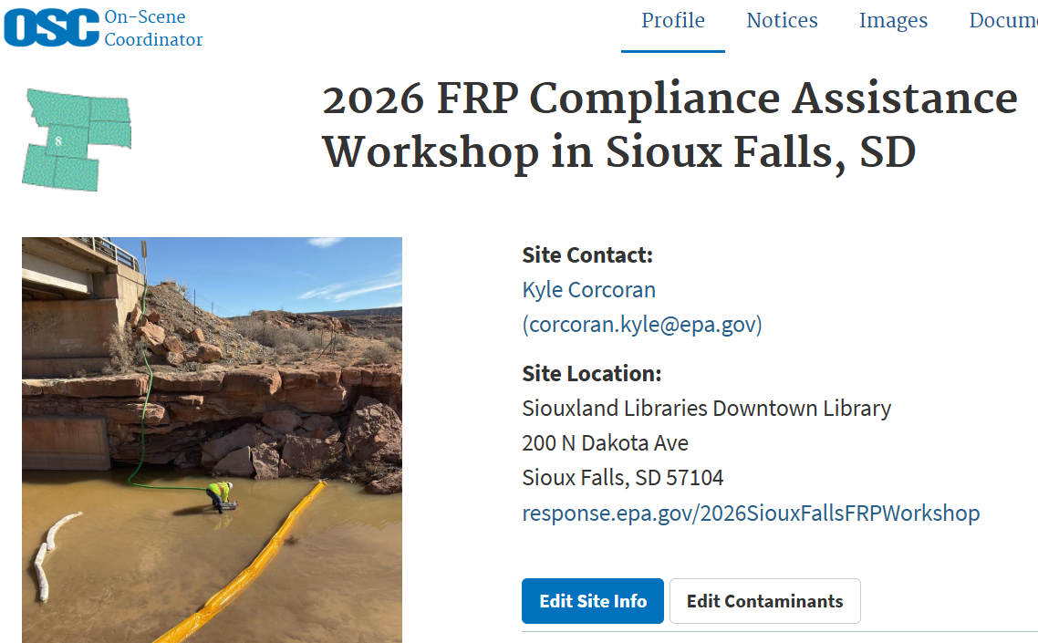

Resources

