Slide 1



Qualified Individual Training
U.S. EPA Region 8 Oil Section
March 25, 2026

Slide 2
Introductions
Steve Merritt – Oil Program Manager / Section Supervisor
Angie Villa – Facility Response Plan Coordinator/Oil Inspector
Kyle B. Corcoran – On-Scene Coordinator
Notes:
Let me take a moment to have my team introduce themselves.
Supervisor Role:
OSC Role:
Coordinator Oil Program Role:
Oil Program Administrative Assistant:
START Contractors :

Slide 3
Participant Introductions
Name
Role
Facility and Location
Experience as a Qualified Individual
What do you expect from this training?
Notes:
Can I get a show of hands if you are designated as a Qualified Individual in your FRP?
Can I get a show of hands if you are a plan writer or compliance person within your organization?

Slide 4
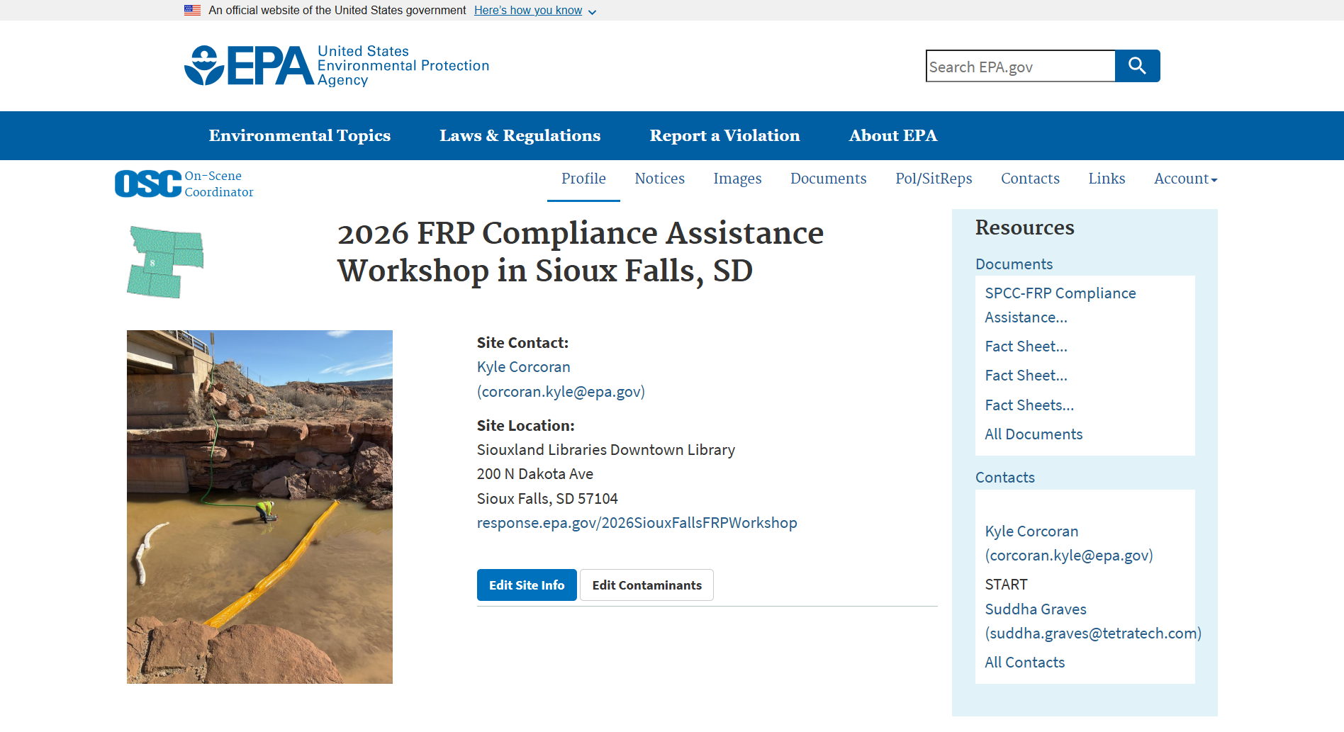
Welcome Back and Opening Remarks
Workshop Materials/Presentations
Participant Feedback Forms
2026 Sioux Falls FRP Workshop
Steve Merritt – Oil Section Supervisor
EPA Workshops and QI Training Intent
RRT Meeting and EPA Region 8 subArea Contingency Plans

Slide 5
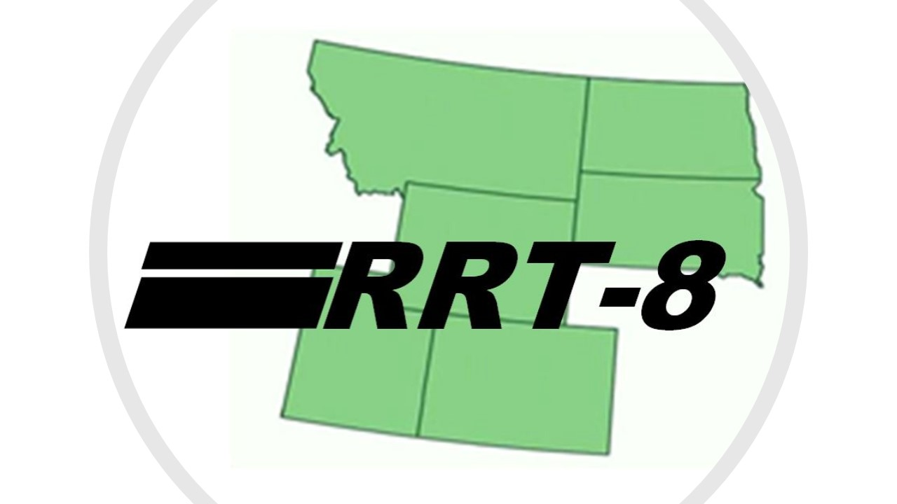
Region 8 Regional Response Team Meeting
April 8, 2026
EPA Region 8 Conference Center (1595 Wynkoop St, Denver, CO 80202)
Incorporating feedback about all 10 subArea Contingency Plans and updates to the Region 8 Area Contingency Plan
RRT Coordinator: cristiano.gina@epa.gov

Slide 6
Recap: Compliance Assistance Workshop
Laws, Regulations & Contingency Plans
Facility Response Plans
SPCC and FRP Inspections
Preparedness for Response Exercise Program
Government-Initiated Unannounced Exercises
QI Responsibilities and Interviews
Reconsideration Requests

Slide 7
QI Training Objective: Pivot to Spill Response
To ensure Facility Response Plan (FRP) facilities have qualified individuals that are aware of the roles and responsibilities outlined in 40 CFR Part 112 and the NCP (40 CFR 300), so they are prepared to effectively respond to a worst-case discharge (WCD).

Slide 8
Agenda
Module 1: Pivot to Spills and Regulatory Context for QIs (Steve)
Module 2: Oil Spill Best Management Practices (Steve and Kyle)
Module 3: Case Studies and Response Actions (Kyle)
Break
Module 4: - Intro to Oil Spill Tabletop Exercise (Kyle)
Lunch
Module 5 - Oil Spill Tabletop Exercise (All)
Module 6: Large/Complex Oil Spill Responses (Steve)
Open Q&A Session, Course Evaluations, and Closing Remarks (All)
Notes:
This is our first time delivering this content and we definitely need your feedback on whether you find it useful in your role as QIs.

Slide 9
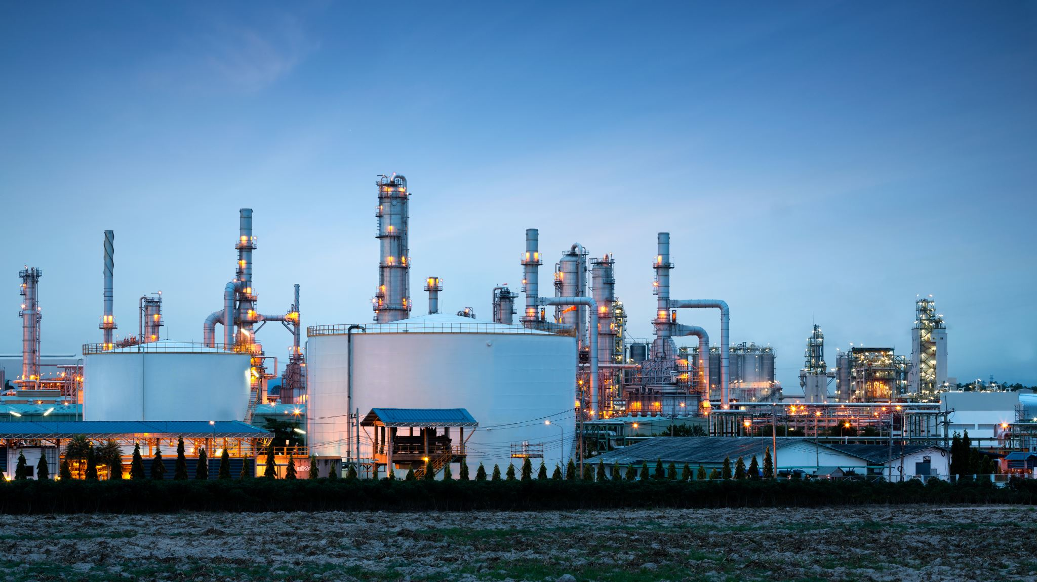
Spill Scenario for QI Training
Medium (NCP - Major) discharge volume (>850 bbls or >36,000 gallons)
Outside containment and impacting WOTUS
Requires external response and cleanup resources
Potential human health and environmental impacts
High interest from the public, media, and elected officials

Slide 10
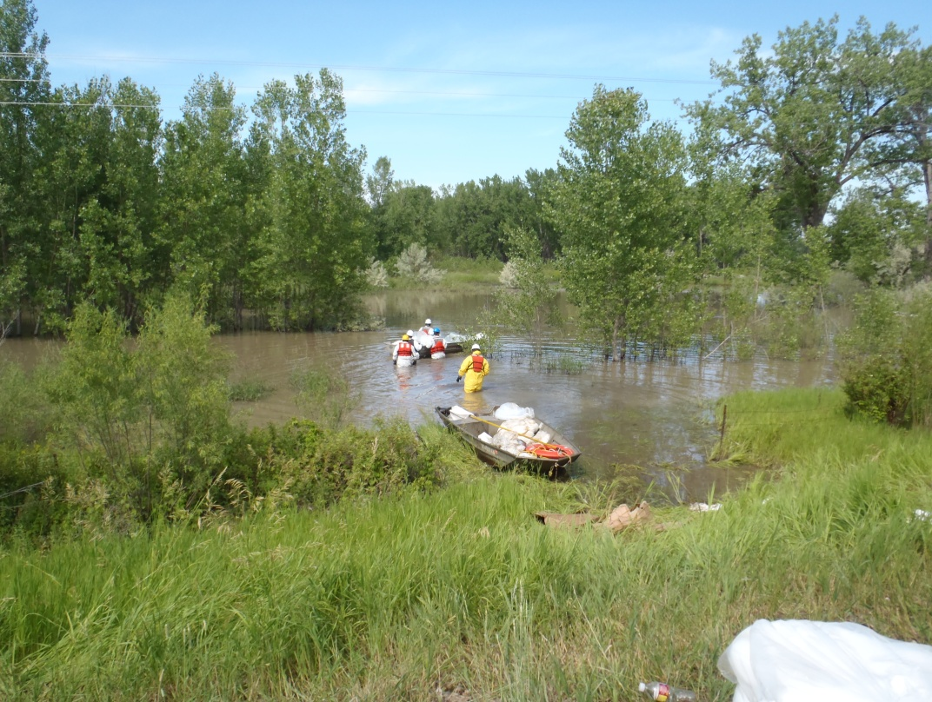
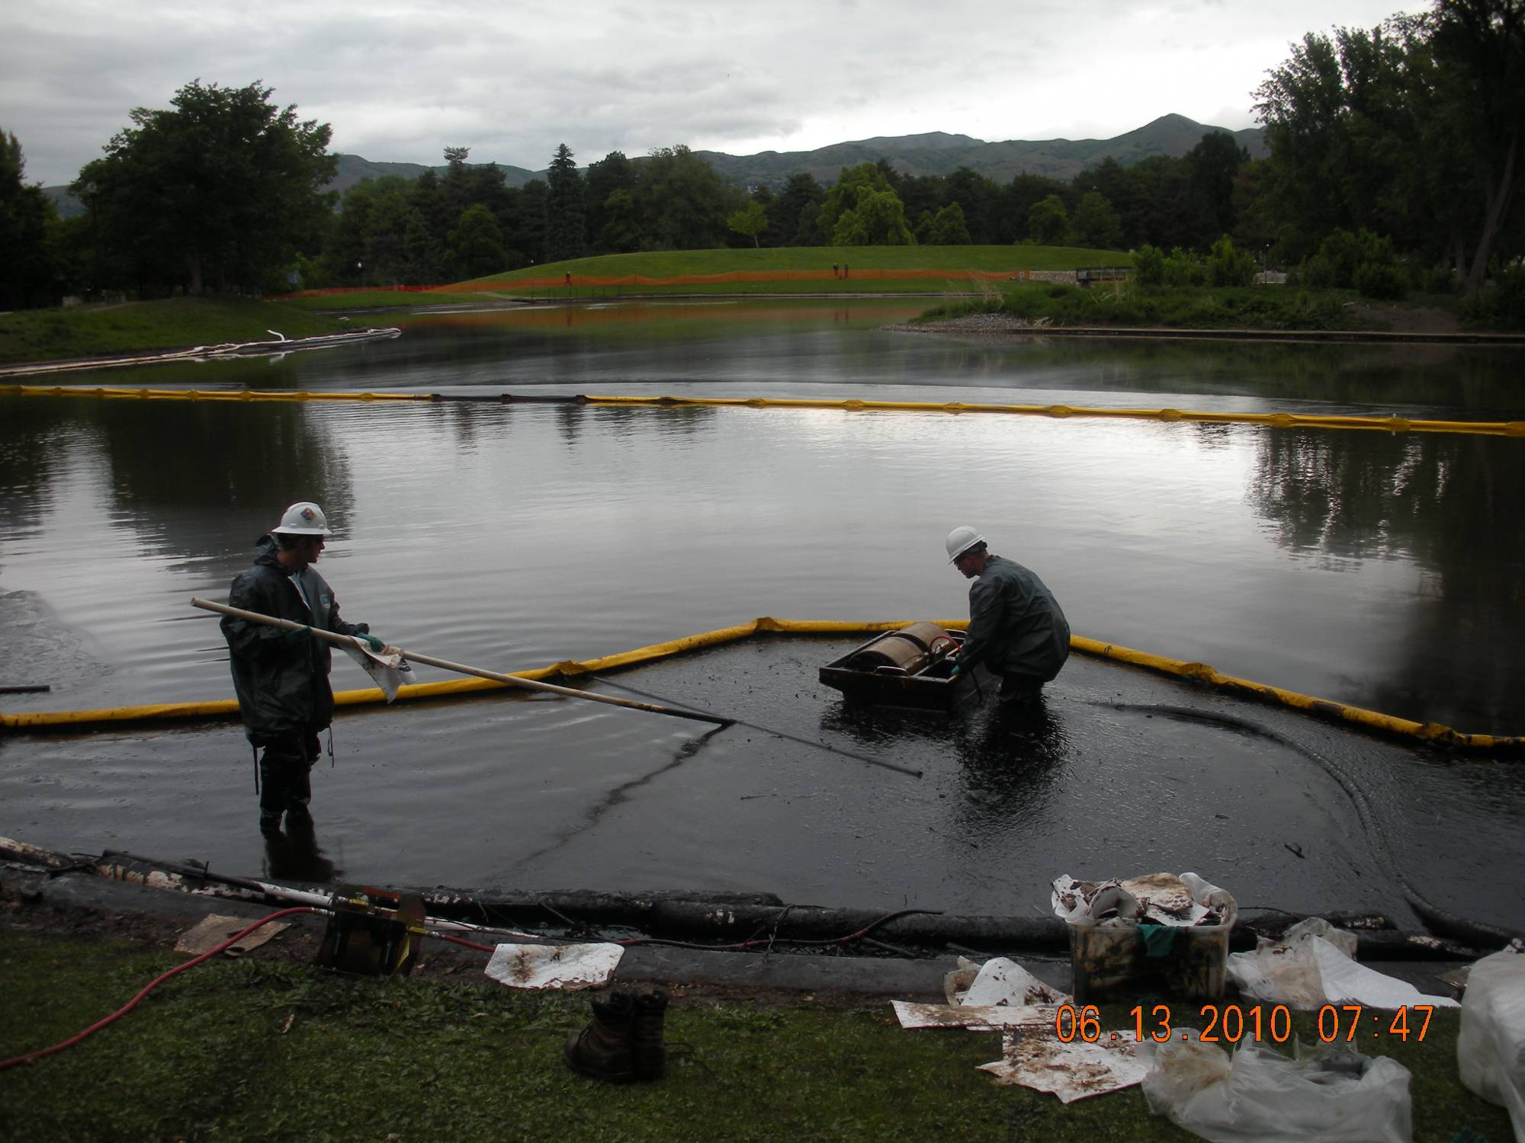
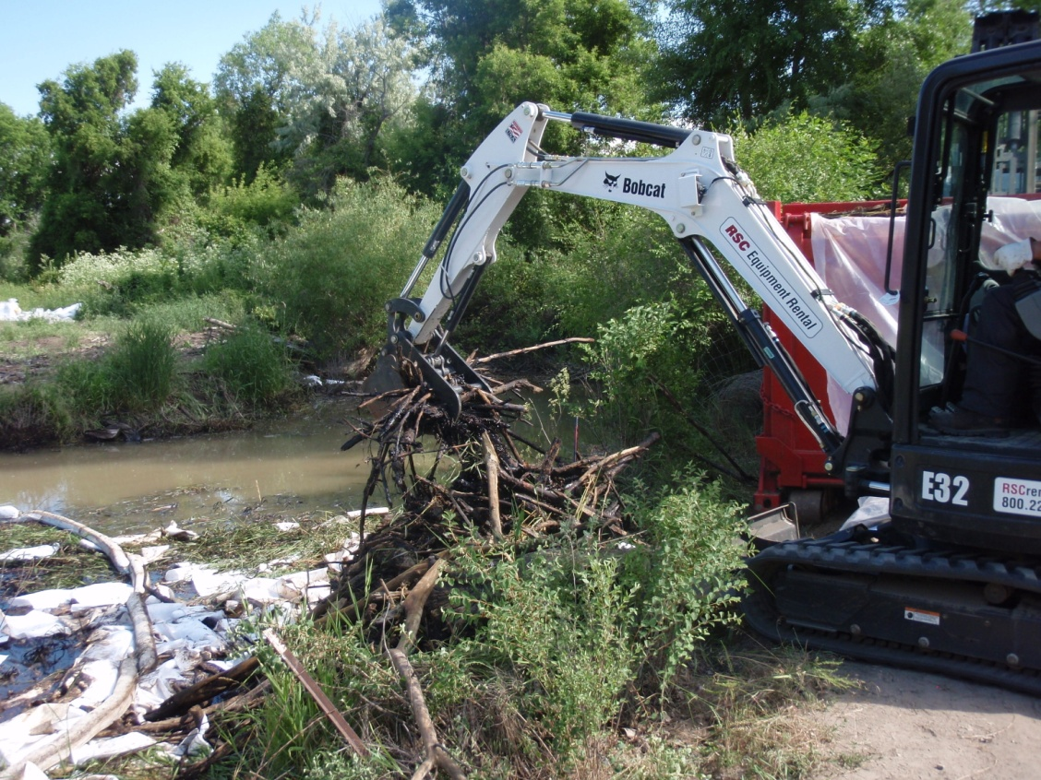
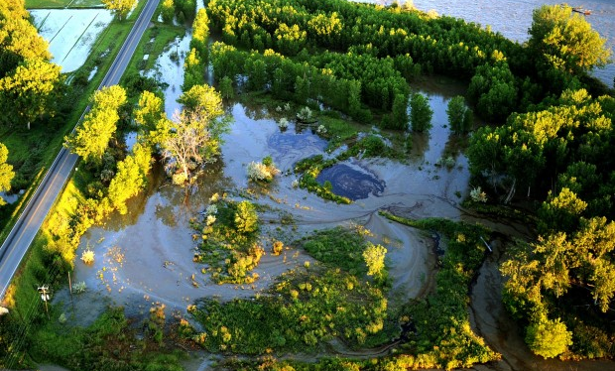
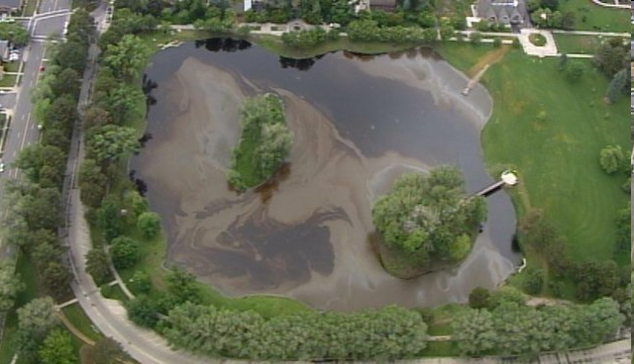
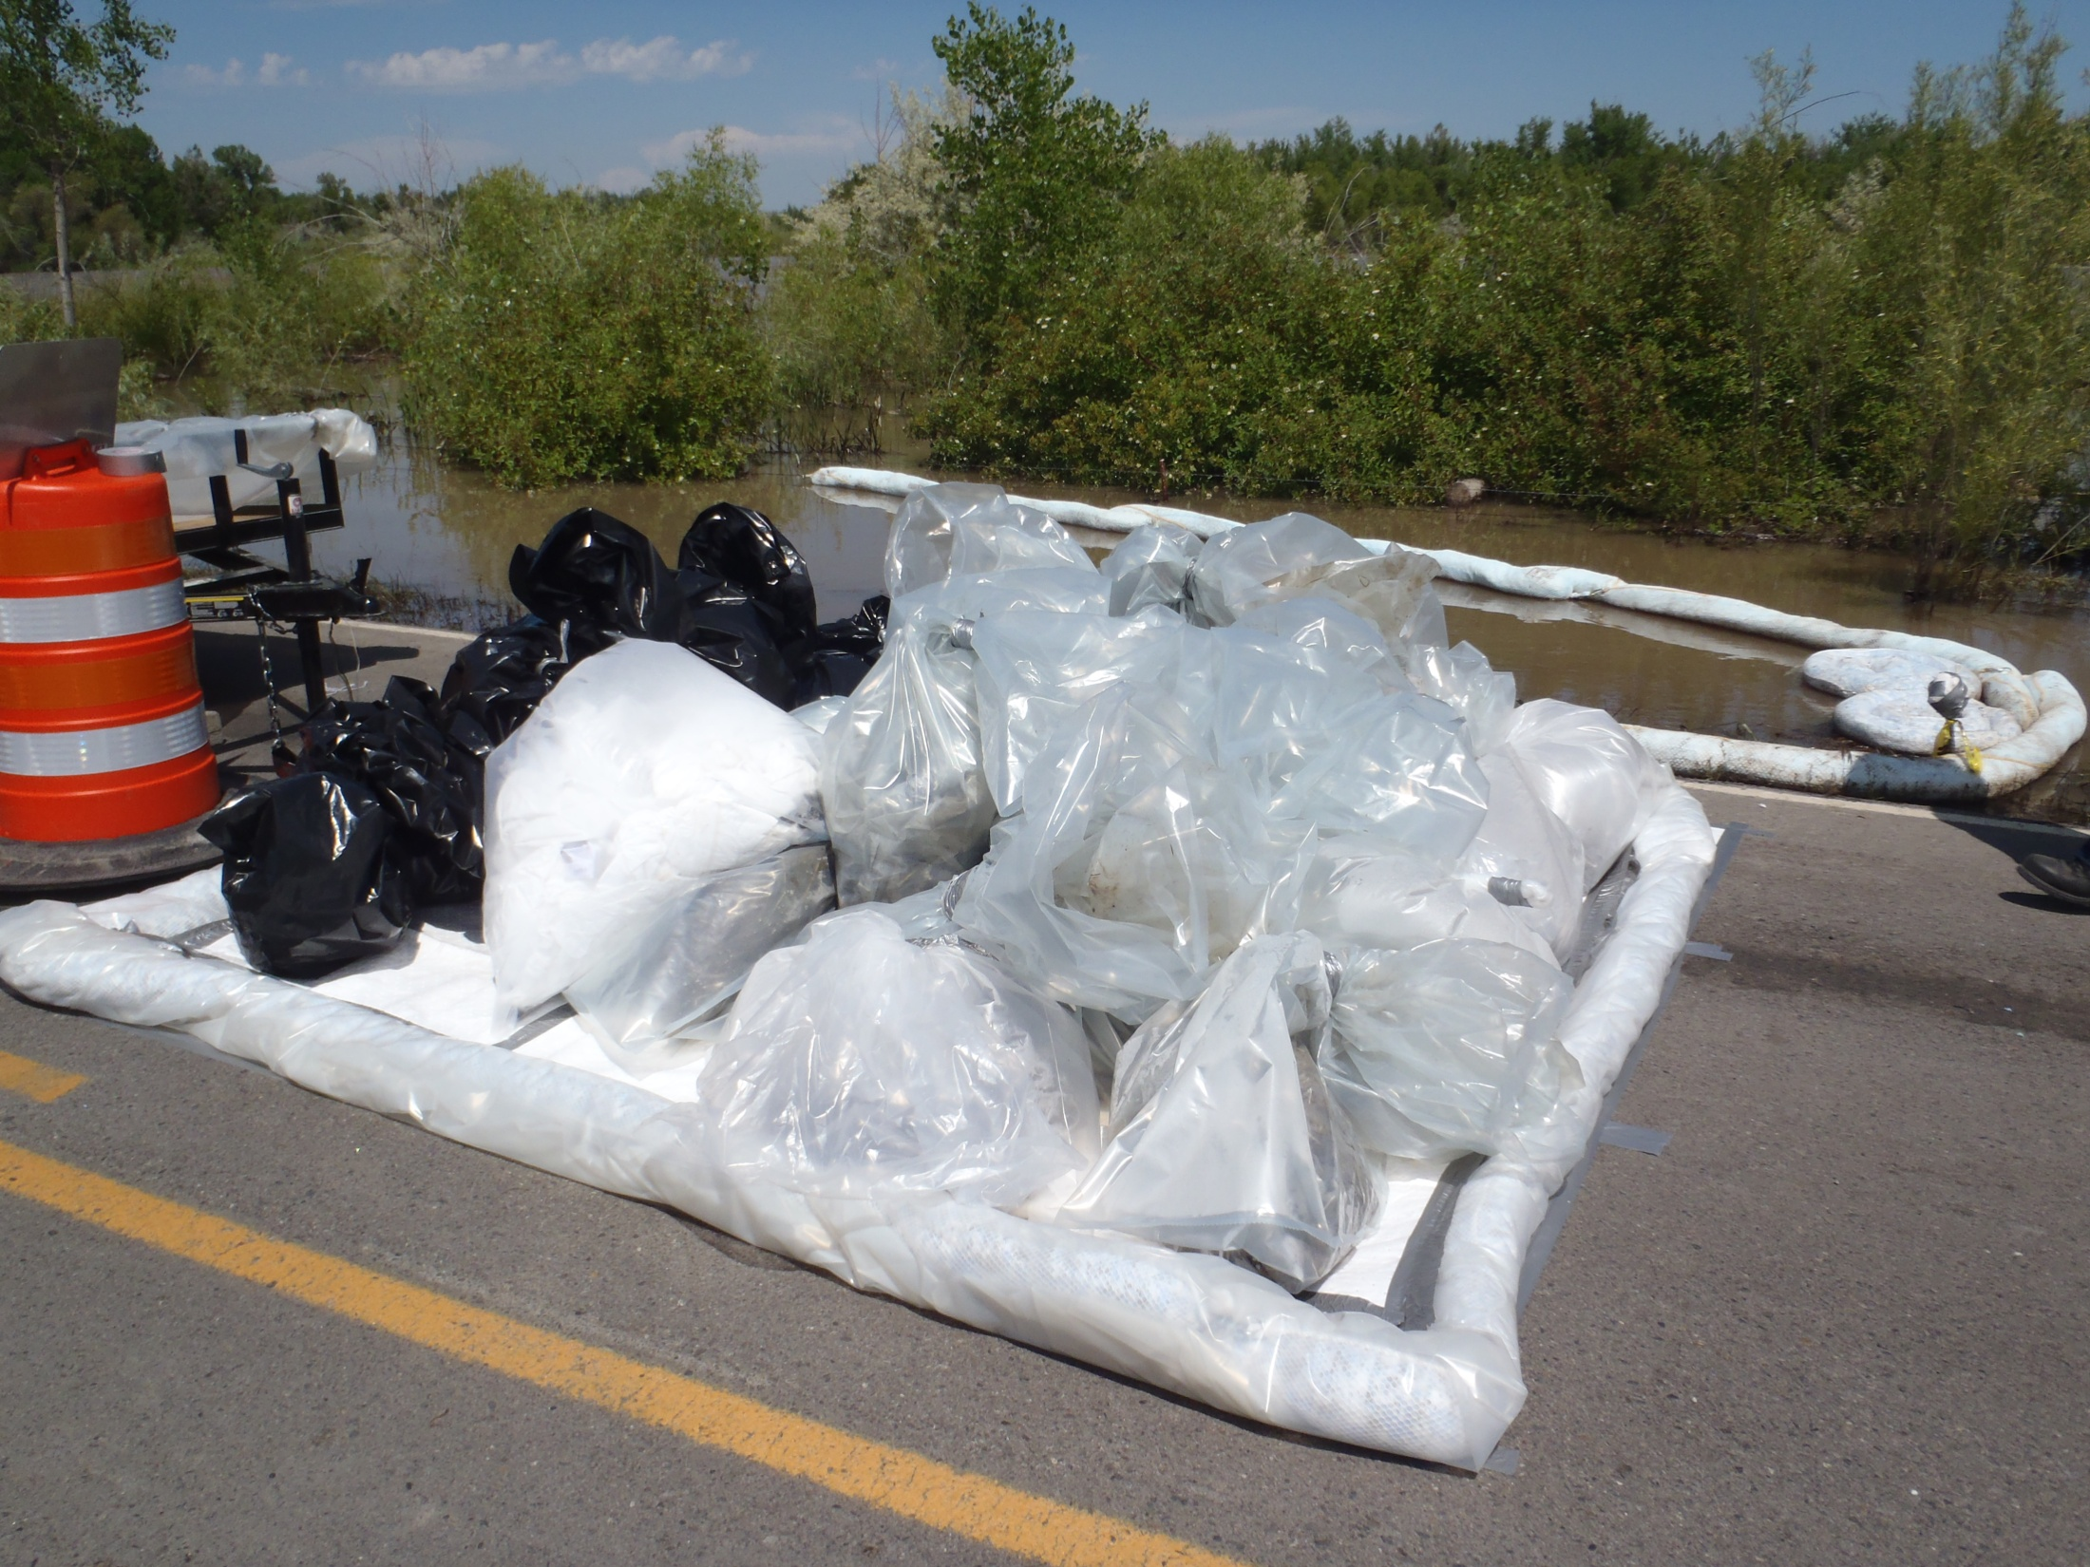
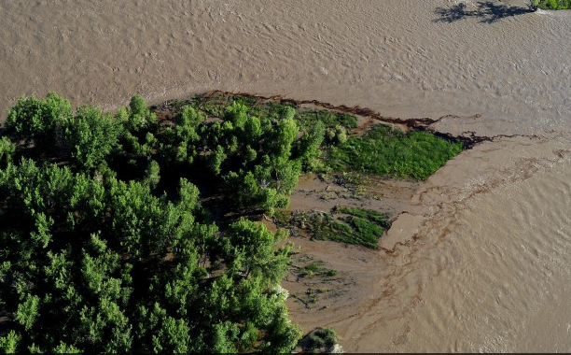
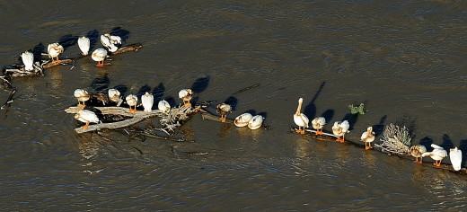
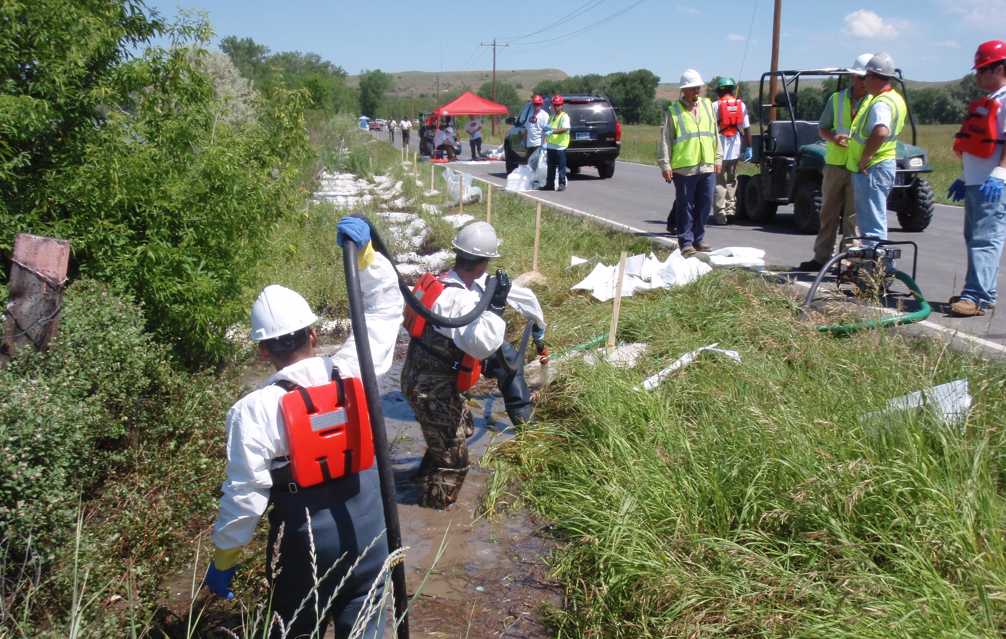
Setting the Stage for
Qualified Individuals
10
Notes:
Welcome and thanks for attending this compliance assistance workshop today. I’m excited to be here and eager for the discussions about the regulations related to oil spill prevention and response. 13 years ago, I was serving as the EPA On-Scene Coordinator and Federal Incident Commander for the unified command response with ExxonMobil to the Silvertip Pipeline Spill into the Yellowstone River near Billings, MT. That spill was caused by late runoff and floodwaters that scoured out a trenched pipeline under the river and released approximately 1,250 bbls (52,000 gallons of crude oil) and impacted land, wildlife, and cultural resources up to 80 miles downstream. The response and cleanup lasted approximately 12 weeks, involving up to 680 responders with a burn rate of up to $1.5 million/day at the peak of the cleanup operations. This response enlisted the assistance of federal, tribal, state, and local resource trustees and emergency response agencies, including the Crow Tribe, who helped provide cultural resource advisors and tribal historic preservation support to the response,.
With this local example in mind, consider that large oil spills can occur even at the most well-prepared facilities, due to human error, equipment failure, natural disasters, vehicle accidents, or intentional acts of sabotage. It is the responsibility of facilities to have plans and procedures in place to prevent spills and respond effectively when these incidents occur and these plans need to be consistent with federal law, regulations, and regional contingency plans. With this workshop we hope to help you improve your plans, exercise and improve your facility response, and prepare for and successfully complete inspections and unannounced exercises at your facility. That’s what we’re going to talk about today.

