Slide 1
Oil Spill Response
Discussion-Based Exercise
Scenario Introduction
Steve Merritt – Oil Section Supervisor
Angie Villa – FRP Coordinator/Oil Inspector
Kyle Corcoran – On-Scene Coordinator
Notes:
So, after the break, we are going to do a mock oil spill exercise. We have selected a plan from a willing audience member and we are going to run an abbreviated GIUE so that everyone knows what to expect, or how a GIUE is run should we show up at your facility in the near future.
EPA will have a few OSCs/FRP coordinators and will split up during the drill to oversee multiple simultaneous actions.
One will be with the QI in the office making notifications and establishing the incident management team. This person will act as the IC, until relieved of their duties during an incident.
The Second will be with an alternate QI, or operations lead who will be in the field mustering responders, completing assessment and initial response actions; source control, containment and recovery operations; and initiating clean-up actions.

Slide 2
Introduce the Oil Spill TTX Panelists
Steven Merritt – Exercise Facilitator
Kim Gardner– EH&S Manager, X Pipelines and Terminals
  Corp/Regional QI/Incident Commander
Jesse Folk – Facility Manager, X Pipelines and Terminals
  Ops/Facility or Alternate QI/Operations
Kyle Corcoran – Kyle Corcoran – On-Scene Coordinator, EPA
  Response Duty OSC and EPA Incident Commander
Angie Villa – On-Scene Coordinator, EPA
  Phone Duty OSC and RRT Coordinator
Jackie McGuire/Kelsey Newling – South Dakota
  Other Federal Agencies, State Environmental Agency, Tribal or Local Emergency Management Entities

Slide 3
Objectives of Oil Spill Tabletop Exercise
Understand the roles of EPA and facility personnel during a WCD
Highlight best management practices employed by X Terminal
Illustrate bifurcated response approach – Primary/Alternate QIs
Demonstrate how WCD knowledge and skills translate to spills

Slide 4
Ground Rules and Reminders
No-Fault Exercise
Notional Scenario
Open Discussion Encouraged
“Phone a Friend” Authorized
Some Use of Imagination Required
Use Your Knowledge of Your FRP and its Capabilities

Slide 5
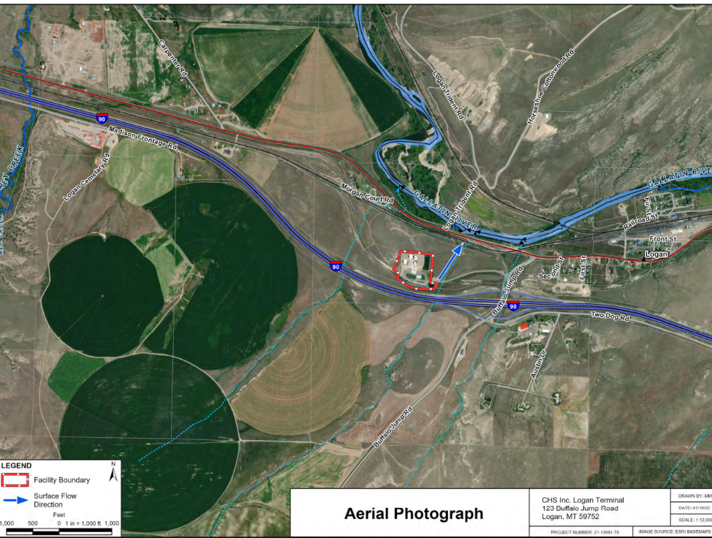
X Terminal Facility Response Plan & Emergency Response Action Plan
 | Incident Command (Primary QI) | Operations (Alternate QI)
Early Response Phase | Discovery Notifications Activate Incident Management Team | Mustering Responders Source Control Retrieving Response Equipment Preliminary Spill Assessments
Intermediate Response Phase | Communicating with Operations Tracking Resources Directing Response | Moving to Control Points Deploying Equipment Containment and Recovery

Slide 6


Critical QI Timeframe and Decisions
Discovery and Notification
Source Control, Containment, and Recovery
Initiating Cleanup Actions
Establishing Incident Management
Assessment and Initial Response Actions
Transferring Incident Management
Activate Alarms
Muster Responders
Contact the NRC
Call the OSRO
Alert Corporate
Activate EOC
Mobilize IMT
Start ICS 201
Designate a PIO
Establish ICP
Gain Access
Plug Culverts/Berm
Survey Spill Path
Get Response Trailer
Identify Oiled Wildlife
Order Vacuum Truck
Shut Valves
Deploy Boom
Skim & Recover
Temporary Storage
Deploy Sorbents
Excavate Oiled Soils
Separate Oily Water
Cut Oiled Vegetation
Recover Sorbents
Dispose of Wastes
Integrate Agencies
Scale the Response
Transition to UC
Develop UC Objectives
Continue Cleanup

Slide 7
Early Response – Initial Response Actions
Discovery and Notification
Establishing Incident Management
Preliminary Assessment
Activate Alarms (IC)
Muster Responders (IC & OPS)
Contact the NRC (IC)
Call the OSRO (IC)
Alert Corporate (IC)
Activate EOC (IC)
Mobilize IMT (IC)
Start ICS 201 (IC)
Designate a PIO (IC)
Establish ICP (IC)
Gain Access (IC)
Source Control (OPS)
Size up (volume estimates) (OPS)
Assessment of what spilled and potential
impacts (OPS)
Survey Spill Path (OPS)

Slide 8
Intermediate Response Phase – Containment/Recovery Actions
Continue Assessments and Initial Response Actions
Source Control, Containment, and Recovery
Initiating Cleanup Actions
Plug Culverts/Berm (OPS)
Survey Spill Path (OPS)
Get Response Trailer (OPS)
Identify Oiled Wildlife (OPS)
Order Vacuum Truck (OPS)
Shut Valves (OPS)
Deploy Boom or alternative containment device (OPS)
Skim & Recover (OPS)
Temporary Storage (OPS)
Deploy Sorbents (OPS)
Excavate Oiled Soils (OPS)
Separate Oily Water (OPS)
Cut Oiled Vegetation (OPS)
Recover Sorbents (OPS)
Dispose of Wastes (OPS)

Slide 9
Worst-Case
Discharge Scenario

Slide 10
Worst-Case Discharge

Slide 11
Worst-Case Discharge

Slide 12
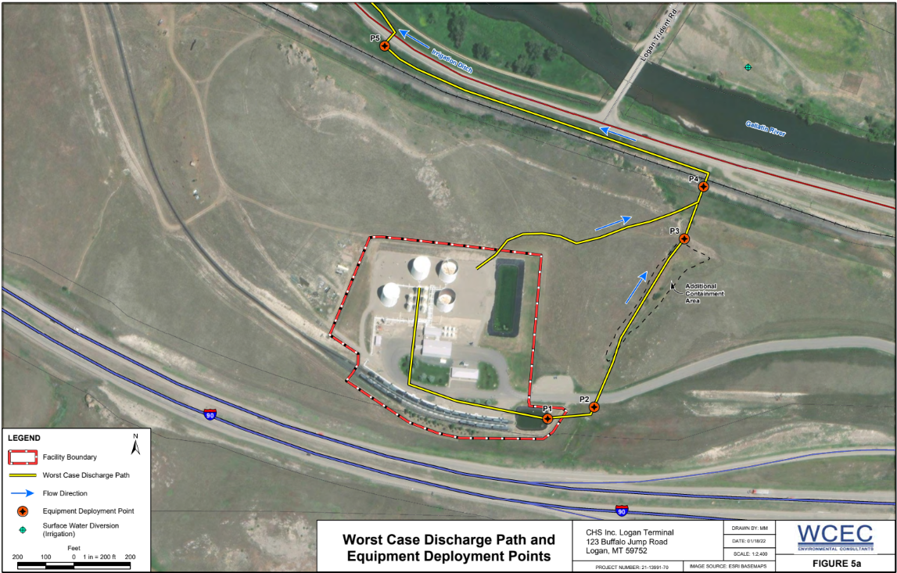

Slide 13
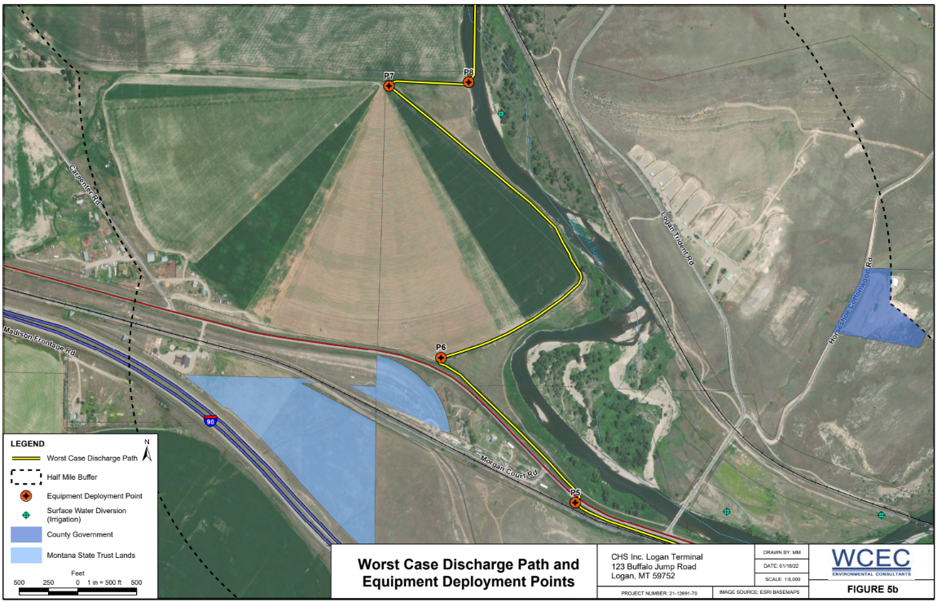

Slide 14
Discovery and Notification

Slide 15
Scenario Update – 4:32 PM
During an afternoon thunderstorm passing through the Gallatin Valley, operators at the facility experience a microburst wind event that crushes the top of AST2 and ultimately causes an instantaneous catastrophic tank failure along the welded seams. The 20,000 bbls of diesel fuel bursts over secondary containment walls to the north and floods into the natural drainage, briefly pooling at the culvert under the railroad track at P4 before filling and overtopping the irrigation ditch at P5. There are 2 personnel still on site, including the Operations QI (Derek). The corporate EHS manager and Incident Management QI (James) is approximately 3 hours away at the refinery control center, initially unaware of the spill.

Slide 17
Spill Discovery – Operations (Jesse)
How would a spill at X Terminal be discovered?
Does the facility have any automatic alarms with leak detection, level metering, or overfill protection?
Do these automatic alarms trigger notifications at the remote corporate control center?
What actions are taken once Corporate is notified of a spill?

Slide 18
Notifications – IC (Kim) and Operations (Jesse)
Internal Notifications
External Notifications
How do you notify response team personnel?
How is corporate or the Regional QI notified?
What other internal notifications are made?
Is the ERAP Notification List used to track notifications?
Who’s calling the NRC and other entities?
How are you fielding calls/inquiries from stakeholders?

Slide 19
National Response Center Report – EPA Phone Duty OSC (Angie)
How does the NRC report from X Terminal come to the PDO?
What actions are you going to take in response to the report?
What triggers deploying the Response Duty OSC to the spill?
What other coordination are you doing for the response while the Response Duty OSC is mobilizing to the scene?
Which agencies get notified automatically by an NRC report?
Notes:
Add a duplicate slide for Kelsey and Jackie for State.

Slide 20
Mustering Responders – Operations (Jesse)
How many responders are on the facility response team?
How long does it take you to notify the facility response team and get them to the rally point on the site after hours?
Do you have any special communication systems for this?
Where is your OSRO coming from and how long does it take to get them to the facility once notified?
Where are you staging responding resources/responders?

Slide 21
Establishing Incident Management

Slide 22
Scenario Update – 4:58 PM
Internal and external notifications have been made and the NRC report is being circulated to agencies, who are responding to the spill. Additional facility personnel and response team members are beginning to muster at the facility and hooking up the spill trailer. Corporate EHS manager and IC QI is on the road to the site with several members of the incident management team with an ETA of 8:00 PM. EPA Response Duty OSC is headed to the airport to catch an evening flight to Bozeman with an ETA of 11:30 PM. Local law enforcement and fire department resources are assisting with traffic control, road closures, and HAZMAT air monitoring. The leading edge of the diesel fuel is flowing quickly down the irrigation canal towards the Gallatin River approaching P6, but nobody has eyes on yet.

Slide 24
Activate Incident Management Team and Establish an Incident Command Post – IC (Kim)
Who makes the decision about activating the incident management team?
What are the triggers?
Where do you setup your command post initially?
Do you have any contingency plans for procuring space beyond the facility?

Slide 25
Ordering and Tracking Resources – IC (Kim) and Operations (Jesse)
Who is responsible for calling the OSRO or the vacuum truck?
How are deployment locations and timing coordinated with operations?
How do you keep tabs on when these orders are received by the spill response team?

Slide 26
Federal Agency Response – EPA Response Duty OSC (Kyle) and Other Agencies (Angie/SD State)
As you’re deploying as the EPA OSC to X Terminal for this response, what information are you needing from the QIs and how are you working to get this?
What resources and personnel are you contemplating needing to activate for this response?
Which other agencies are you coordinating with?
What are their roles and capabilities?
Notes:
Has oil hit water (WOTUS)
Are facility Emergency Responders on scene - How many people on scene
How long before OSRO's on site
Is oil contained/boom deployed
Is wildlife impacted
Is residents impacted
Fire/explosion risks
Evacuations
Air monitoring
Coordinating - USFWS, BLM, SHPO/THPO, RRT, USACE, NOAA, State/Local

Slide 27
Local and State Response - Emergency Management and State Environmental (SD State)
What role is the Gallatin County Emergency Manager playing in the response following notification?
How are the local police and fire department assets coordinating with the facility incident responders?
How long are they likely to be involved in the response and in what capacity?
Besides the SD Department of Agriculture and Natural Resources, what other state agencies might need to be notified as part of this oil spill?
What are their roles likely to be?

Slide 28
Preliminary Assessment

Slide 29
Scenario Update – 5:15 PM
Diesel fuel is flowing in the irrigation canal at P7 and could be observed by the facility recon team. The spill trailer and response team are ready to roll toward P8 to attempt to get containment boom deployed and prevent it from reaching the Gallatin River. OSRO resources are en route to the facility and have been directed to stage at and deploy boom at fishing access point on the Gallatin River approximately 1 mile downstream of the irrigation ditch outfall, but it their ETA is unknown. A contracted vacuum truck and skimmer are rolling in the front gate of the facility now.

Slide 31
Source Control – Operations (Jesse)
What steps are required to shut off the facility and isolate the damaged tankage from manifolds or transfer areas?
Can this be performed remotely from a control center?
Is this a priority before deploying spill response resources and how many personnel might be involved?

Slide 32
Preliminary Spill Assessments – Operations (Jesse)
Who is doing the reconnaissance to determine the location of the leading edge of the spill and flow path?
How do they report this size-up information to the response team to inform decision-making?

Slide 33
Deploying Response Resources – Operations (Jesse)
Where are the response resources stored and who is responsible for getting them ready to deploy?
How do you handle tailgate safety briefings for your response team and when is that done?
When and how is the decision made as to where to deploy these resources?
Who makes that call?

Slide 34
Response Communications – IC (Kim)
How does the Regional QI or IMT maintain situational awareness as to what’s happening in the field while in route to the spill?
Are there regular reporting intervals for calls?
Are there any special communications tools or equipment used by your facility?
How are you coordinating with responding agencies and combatting the “fog of war”?

Slide 35
Initial Response Actions

Slide 36
Scenario Update – 5:45 PM to 6:30 PM
All pipelines have been shut in and the source is secured at X Terminal. The leading edge of diesel fuel is flowing through the irrigation canal outfall at P8 into the Gallatin River. There are migratory birds taking shelter from the storm in an oxbow under overhanging cottonwoods just downstream. The spill trailer, vacuum truck, and skimmer are at P8 and containment boom is being deployed, but thunderstorms are slowing progress. OSRO resources are headed to deploy boom at the Missouri Headwaters State Park fishing access point on the Gallatin River at P9. Media has picked up the story from police scanners and there are reporters at the gate taking video for the 10 PM news.

Slide 38
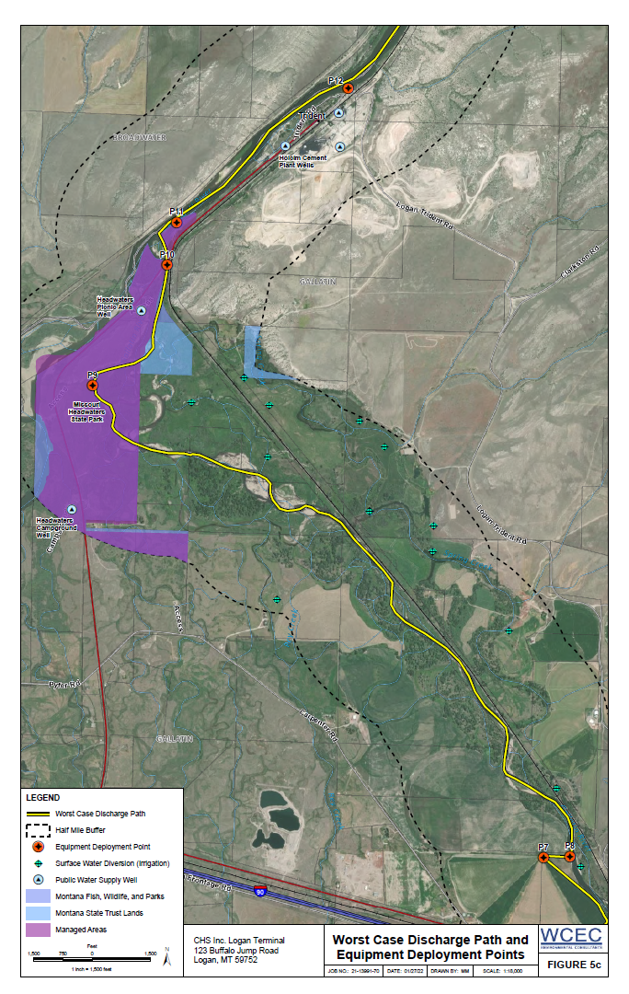

Slide 39
Deploying to Control Points – Operations (Jesse)
Where is your “Alamo” point for your facility?
What criteria and information are you synthesizing to determine where to deploy response equipment?
Do you have any control points where you’re using anything besides containment boom to stop the flow of oil?
How long does it take your response team to get containment boom set at the “Alamo” point?
Are you working back upstream from there, if time permits?

Slide 40
Directing Response Actions – IC (Kim) and Operations (Jesse)
Is the Operations QI empowered to direct tactics during the emergency response phase?
Are there any unusual circumstances, like firefighting or natural disaster, which might require consultation or guidance with the lC QI?
How much coordination is taking place between Operations and IC QI during this phase?
How is that occurring and in which direction(s) is information flowing?
What is the IC QI doing to help keep Operations focused on response tactics?

Slide 41
Containment and Recovery, Transition to Unified Command

Slide 42
Scenario Update – 7:00 PM to Midnight
Facility responders have containment and recovery in place at P8 and are skimming diesel fuel into the vacuum truck. OSRO is getting boom deployed at the Missouri Headwaters State Park (P9), which is the “Alamo” point for X Terminal. There are reports about oiled wildlife and concerns about potential tribal and historic cultural resource impacts at the State Park. 24-hour operations have commenced and both P8 and P9 have requested emergency lighting, a plan for field crew support, and a waste management plan for PPE and saturated sorbents. IC QI has arrived at X Terminal with the State Environmental Agency and local Emergency Manager. The EPA OSC is showing up shortly, expecting to join in Unified Command and initiate the ICS planning P process to develop an Incident Action Plan.

Slide 45
Containment and Recovery – Operations (Jesse)
How quickly can your response team deploy equipment once at your “Alamo” control point?
What response equipment is organic and what equipment is coming from external sources?
Do you have various types of containment and recovery equipment available?
Are you using temporary storage tanks at your collection locations or transporting recovered oil somewhere else?

Slide 46
Joining Unified Command – EPA Response Duty OSC (Kyle)
What are your expectations about establishing Unified Command with industry and others upon arrival at the spill?
Which other agencies are you going to bring in?
How will you help address the media interest in the spill?
How can you assist the X Terminal with response coordination?
How will you begin assessing the adequacy of the response and cleanup efforts?
Notes:
Incident brief 201
Incorporating federal and state OSC and other agencies (USFWS)
Need additional resources (ERRS/START)
USFWS
USACE
NOAA – Spill modeling/hydrology expertise/scientific support coordinators for countermeasures
RRT
US Coast Guard
Bring PIO to work with industry PIO – relaying coordinated response effort
Liaison - operations/safety/technical resources/PERFAS
Containment/recovery/etc - looking at the same thing I look at in a GIUE.

Slide 47
Response Coordination - State, Tribal, and Local Responders (SD State)
What information do you need from the IC QI to being participating in unified command?
What expectations do you have about participating in decision-making at the response?
What else are you looking at or confirming with respect to evaluating the incident management?

Slide 48
End of Exercise and Debriefing

Slide 49
Key Takeaways?
Bifurcated Response Approach – IC QI and Operations QI
Fog of War and Increasing Complexity
Scale Quickly and Demobilize Unnecessary Resources, If Needed
Focus on Unburdening Operations to Speed Deployment
Have Control Points and Response Strategies Established
Know Your “Alamo” Point
Train Your Responders and Your OSRO

Slide 50
Feedback
Was this useful?
Which parts?
What would you add/remove?
How does this discussion make you rethink your FRP?

